Slide 1

Sorting Algorithm Visualizer
Course Name: Algorithms Lab
Course Code: CSE 208 Course Section: 251_D4
Presented By
Jonayet Bogdady
ID: 251002011
Presented to
Ms. Jarin Tasnim Tonvi
Lecturer, Department of CSE
Green University of Bangladesh

Slide 2
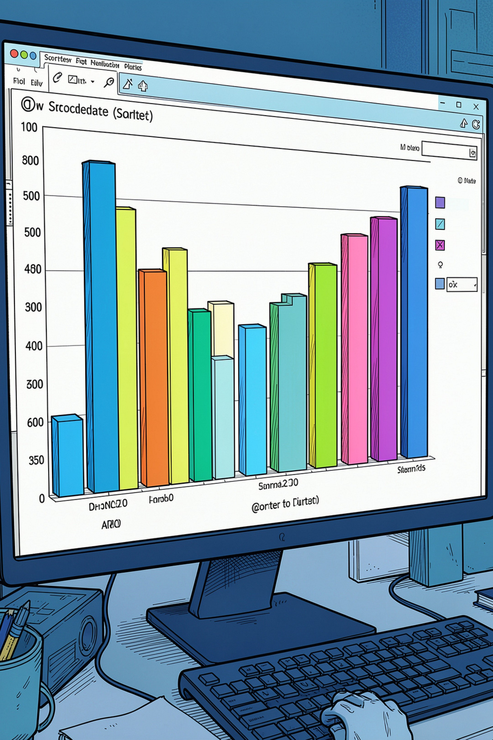
What Is Sorting — and Why Does It Matter?
Sorting Defined
Arranging elements in a specific order — typically ascending or descending — based on a comparison rule.
Why It's Fundamental
Sorting underpins search, databases, data compression, and virtually every real-world software system.
This Project
A visualizer that animates five classic sorting algorithms, counts operations, and measures execution time.
01

Slide 3
Project Objectives
Visualize Algorithms
Five Algorithms
Animate each step of sorting with horizontal bar charts.
Bubble, Selection, Insertion, Merge, and Quick Sort.
Flexible Input
Count Operations
Accept both manually entered and randomly generated arrays.
Track comparisons and swaps/movements for each run.
Measure Time
Display Complexity
Record wall-clock execution time per algorithm.
Show best, average, and worst-case Big-O notations.
02

Slide 4
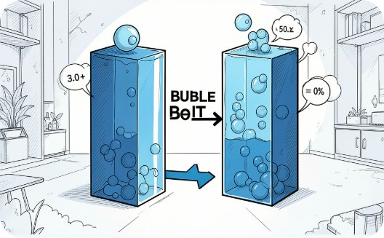
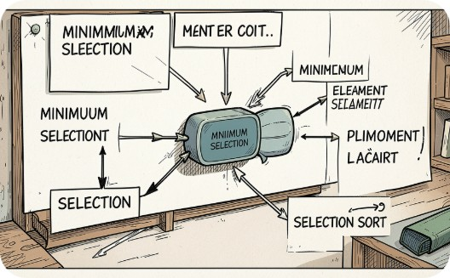

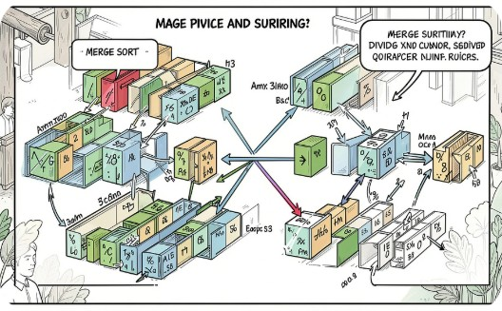
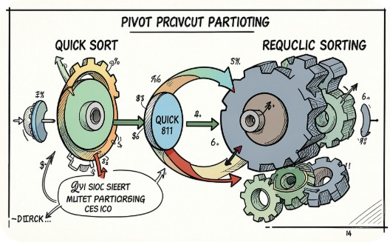
Sorting Algorithms Implemented
Bubble Sort
Selection Sort
Insertion Sort
Merge Sort
Repeatedly swaps adjacent pairs that are out of order.
Selects the smallest element and places it in correct position.
Builds a sorted portion by inserting elements one at a time.
Divide-and-conquer: splits, sorts, and merges sub-arrays.
Quick Sort
Partitions around a pivot and recursively sorts each side.
03

Slide 5
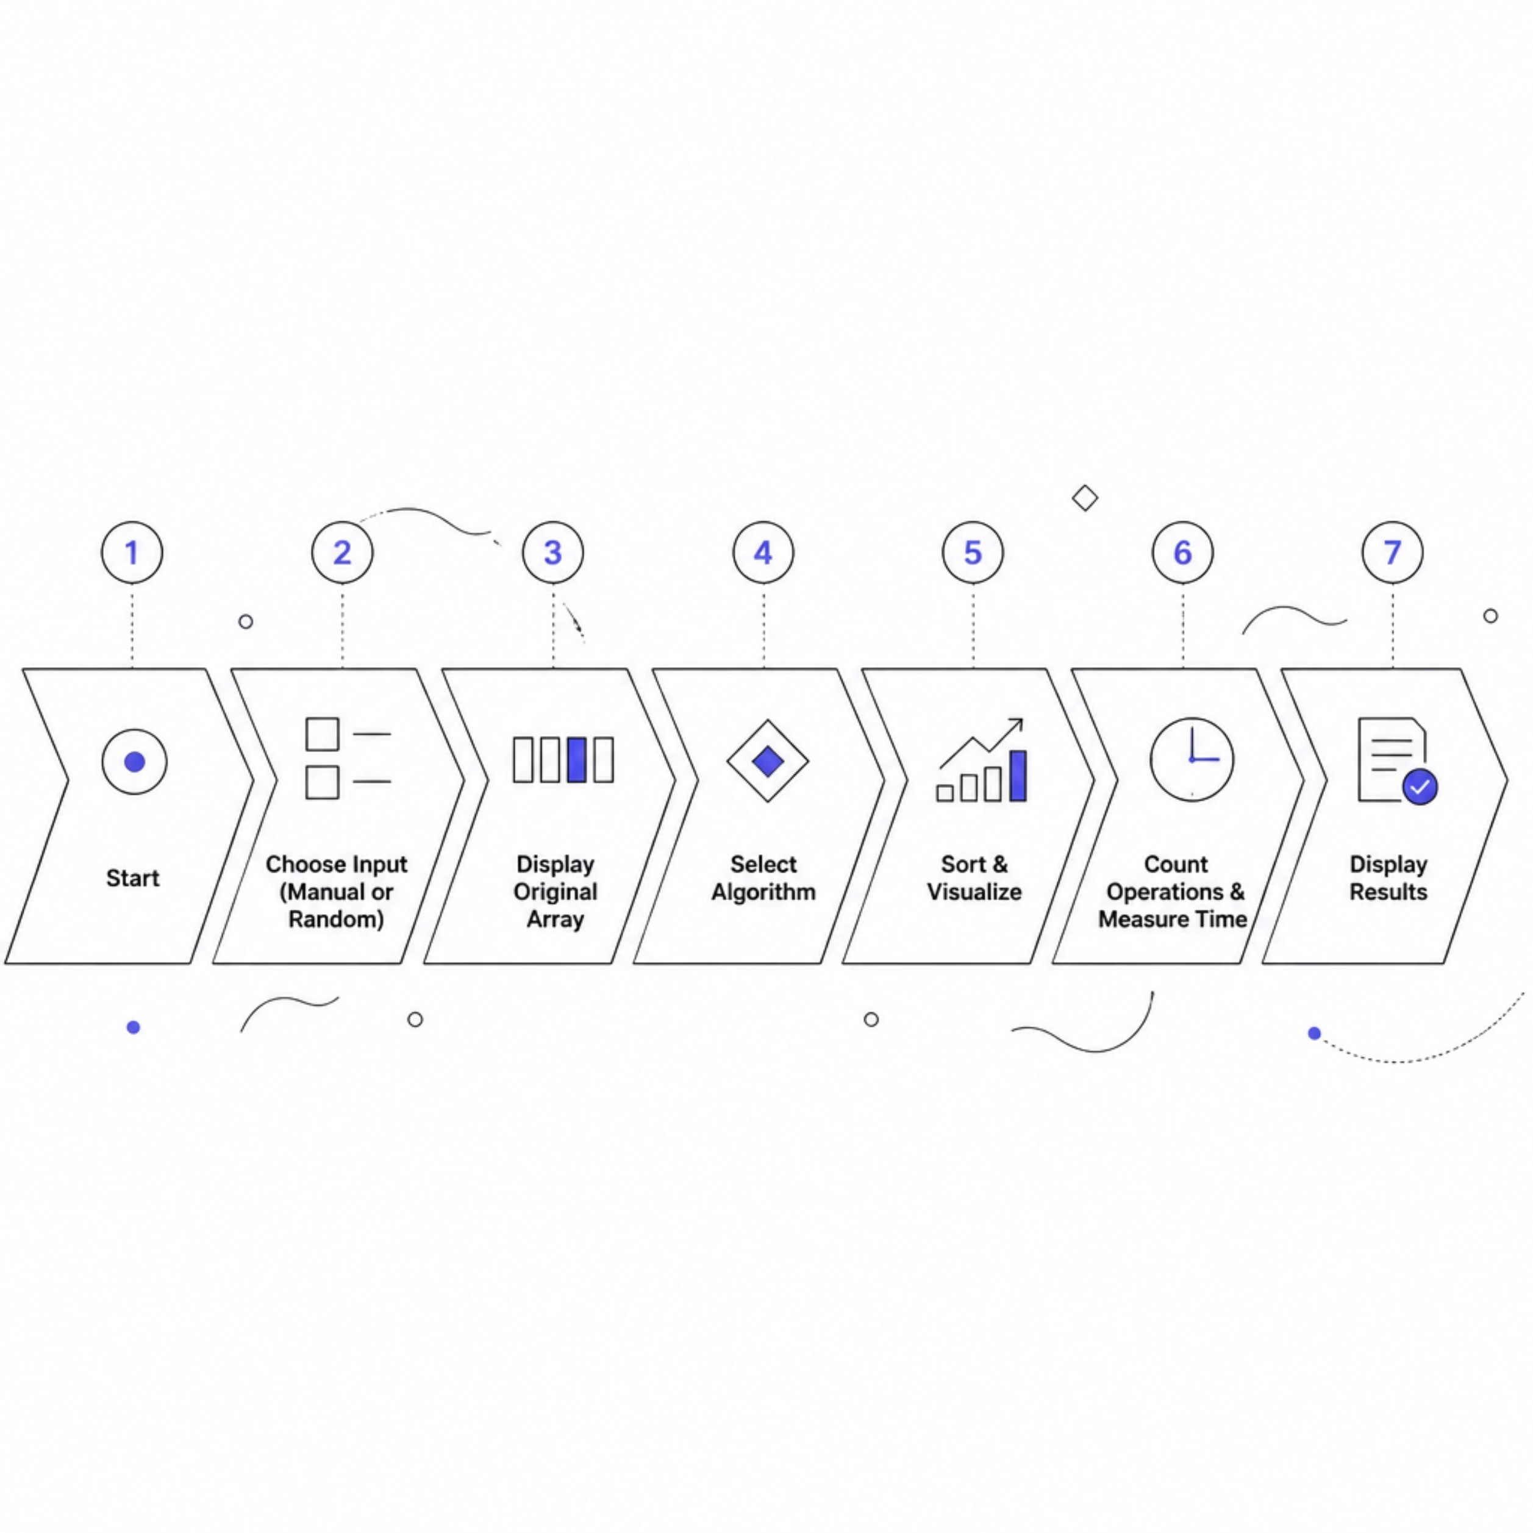
System Workflow
The visualizer follows a clear, linear flow — from input selection through algorithm execution to result display with operation counts and timing.
User chooses manual or random array input
Original array is displayed as horizontal bars
User selects one of five sorting algorithms
Algorithm runs with live step-by-step visualization
Comparisons, swaps, and execution time are recorded
Final sorted array and statistics are displayed
04

Slide 6
Technologies Used
Technology
Purpose
C Language
Core simulator development
VS Code
Code editing and debugging
GCC (MinGW)
Compilation on Windows
Windows CMD
Program execution and I/O
06
05

Slide 7
Algorithm Complexity Comparison
Algorithm
Best Case
Average Case
Worst Case
Bubble Sort
O(n)
O(n²)
O(n²)
Selection Sort
O(n²)
O(n²)
O(n²)
Insertion Sort
O(n)
O(n²)
O(n²)
Merge Sort
O(n log n)
O(n log n)
O(n log n)
Quick Sort
O(n log n)
O(n log n)
O(n²)
Merge Sort offers the most consistent performance. Quick Sort is fastest on average but degrades to O(n²) with poor pivot choices.
06

Slide 8
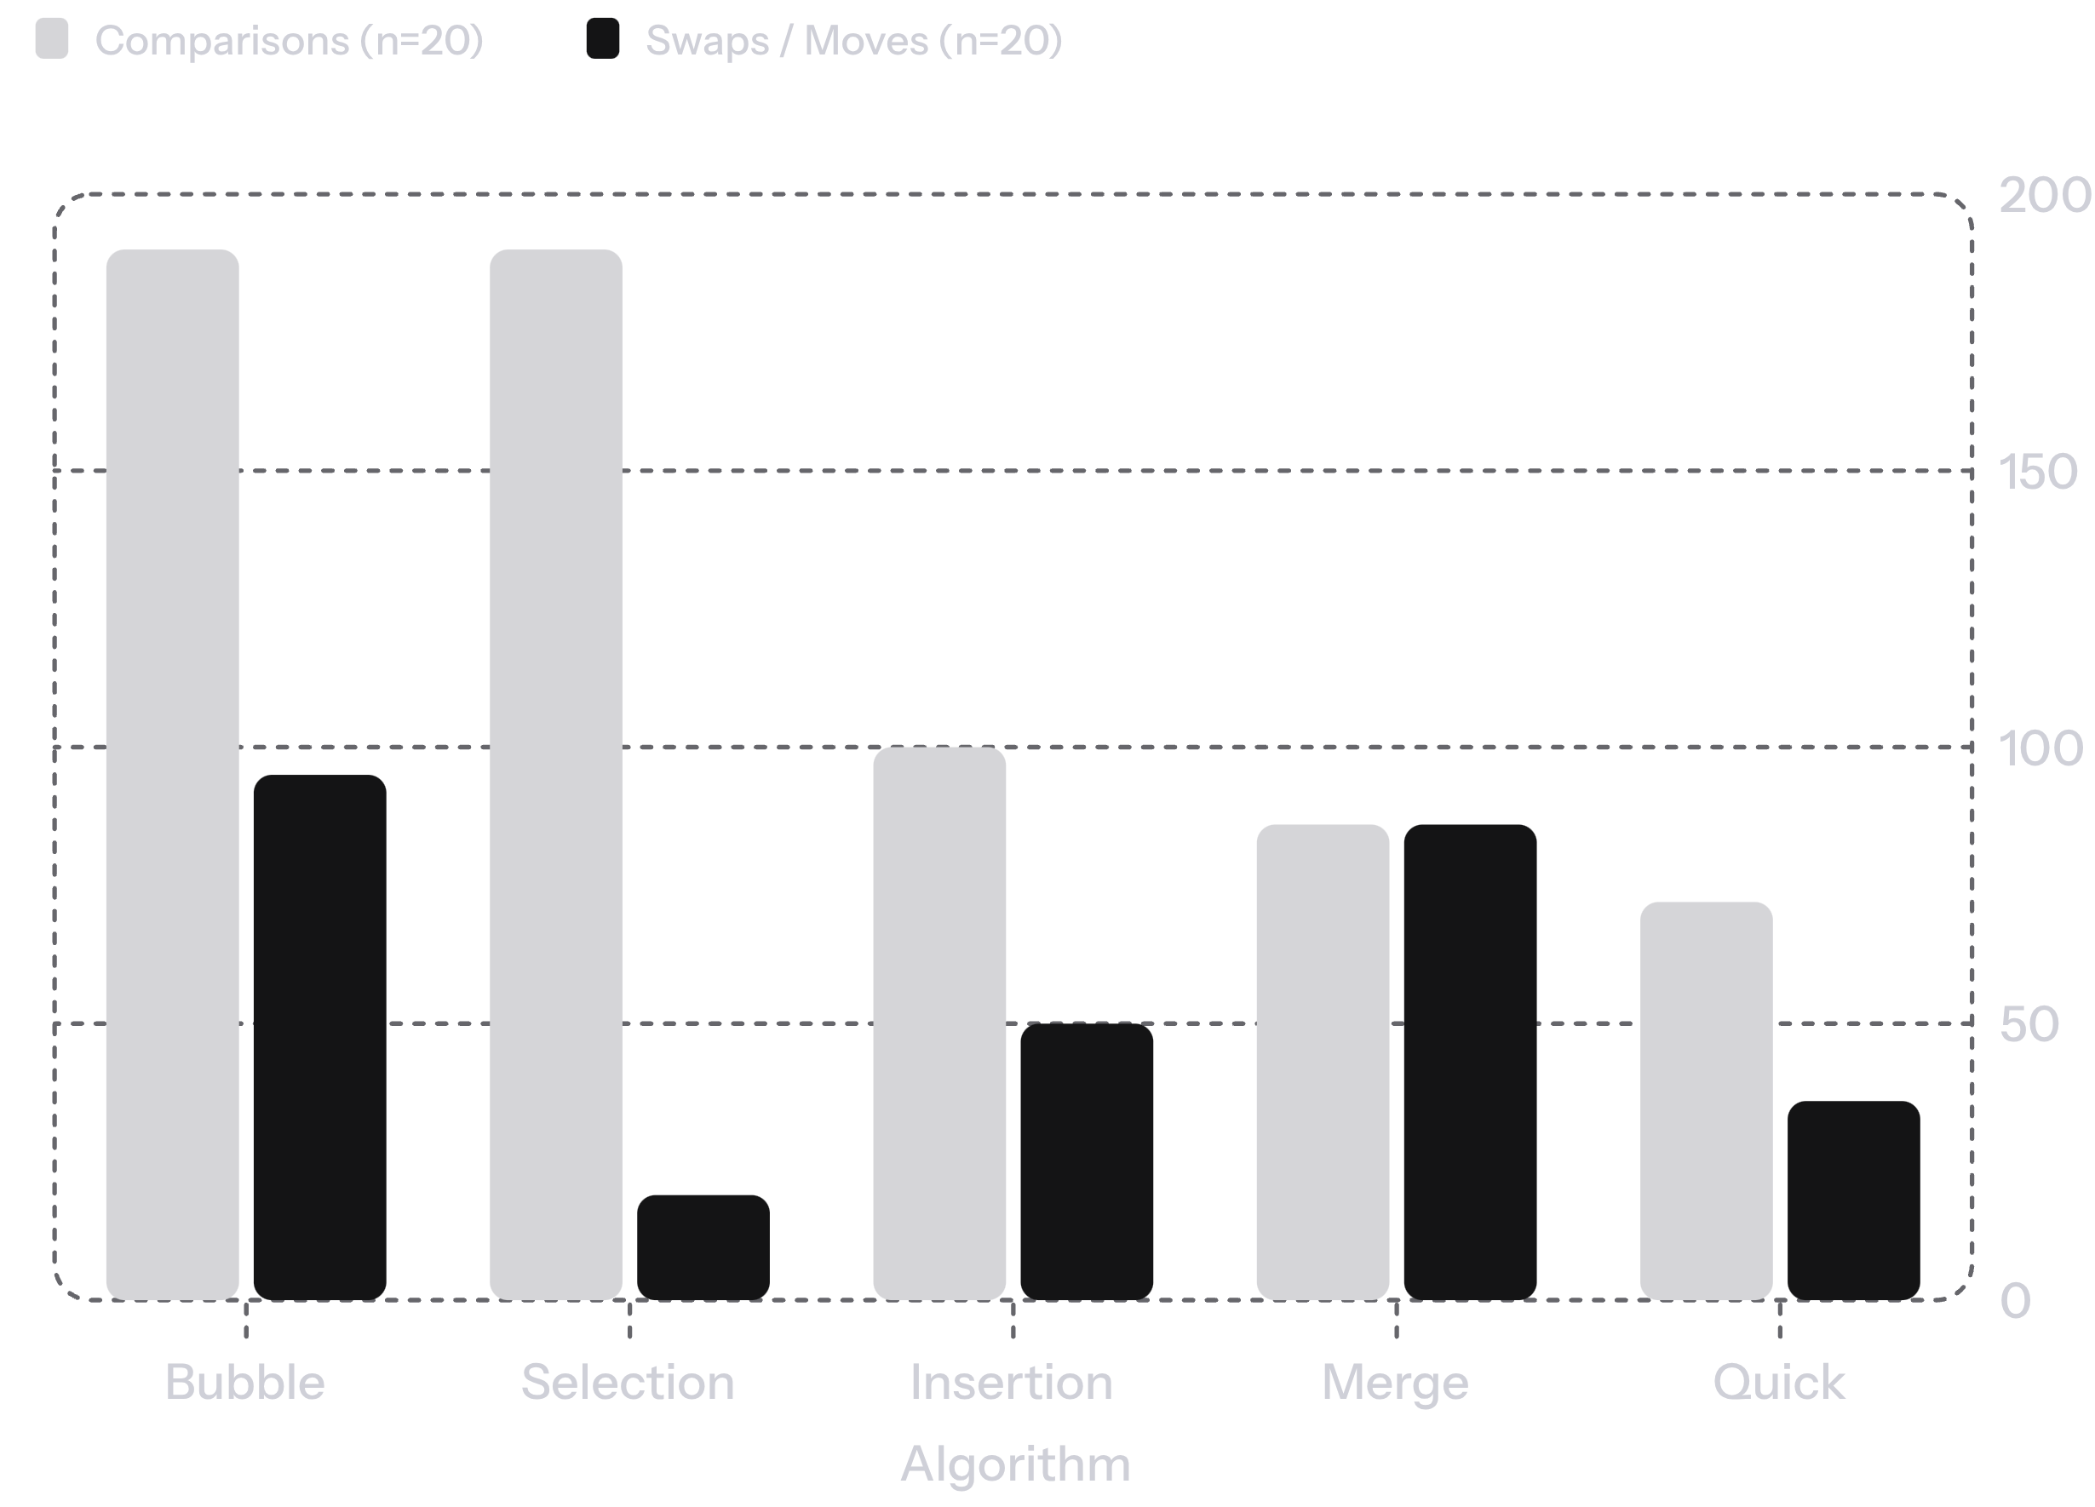
Performance Measurement
What We Measure
Comparisons
Total element-to-element comparisons performed.
Swaps / Moves
Actual data movements or exchanges executed.
Execution Time
Values are illustrative — replace with actual test results from your program runs.
Wall-clock time in milliseconds per algorithm run.
07

Slide 9
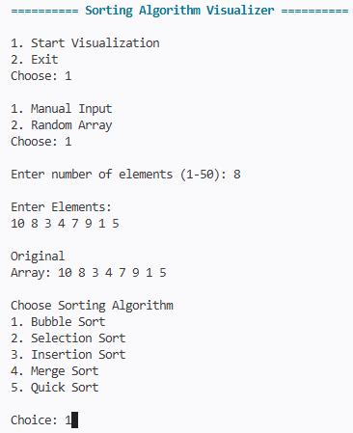
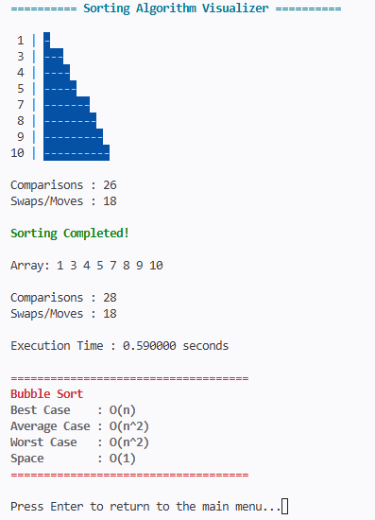
Program Demonstration
Main Menu
Final Statistics
Configuration and mode selection.
Hit/miss ratios and access counts.
08

Slide 10
Conclusion & Future Work
✅ What We Achieved
🔭 Future Improvements
Visualized 5 sorting algorithms with live animation
Tracked comparisons, swaps, and execution time
Supported both manual and random array input
Displayed Big-O complexity for each algorithm
Full GUI with speed control & step-by-step mode
Add more algorithms (Heap, Radix, Shell Sort)
Graph-based comparison charts and export
Cross-platform support (web & desktop)
🎓 Learning Outcomes
Deepened understanding of algorithmic behavior
Practiced performance measurement and analysis
09

Slide 11
Thank You Everyone!
THE END!

